Slide 1
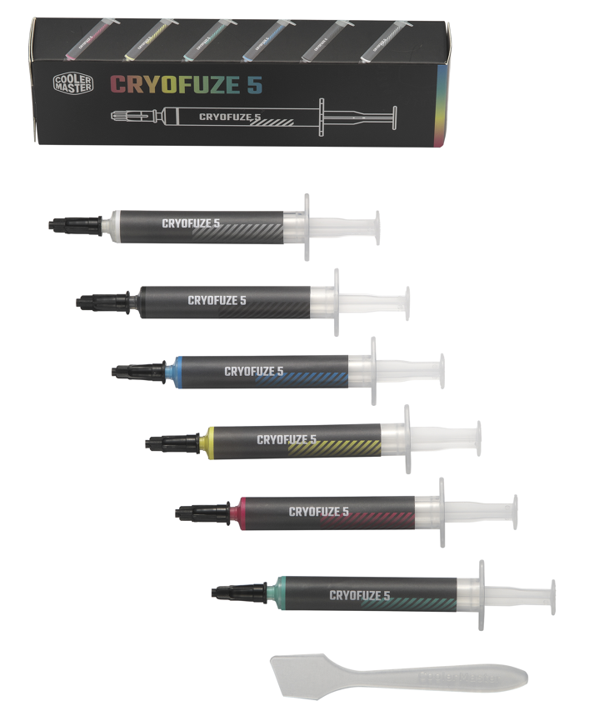


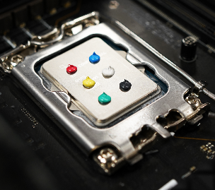


Building on the popularity of our CryoFuze Violet thermal paste, Cooler Master is adding more colors to the CryoFuze with CryoFuze 5. Featuring a multi-color, nanoparticle-based compound, CryoFuze 5 provides excellent thermal conductivity on all processing components. Its low thermal impedance greatly improves performance while a balanced viscosity and electrically insulated composition delivers exceptional bonding with effortless application and clean up. CryoFuze 5 is non-corrosive and oxidation resistant, leaving contact surfaces unharmed and preventing solidification and drying. CryoFuze 5 has a versatile range of temperature performance, maintaining stability from -50°C up to 240°C. Brighten up your cooling performance with CryoFuze 5.
CRYOFUZE VIOLET 5
Exceptional thermal conductivity
Multi-color
compound
Anhygroscopic composition
Exceptional thermal conductivity handles even the most extreme system builds.
A multi-color compound utilizes a superior composition.
An Anhygroscopic formula with a balanced viscosity and electrical insulation allow for easy application and clean up.

Slide 2


Exceptional thermal conductivity - Exceptional thermal conductivity handles even the most extreme system builds.
Multi-color compound - A multi-color compound utilizes a superior composition.
Anhygroscopic composition - An Anhygroscopic formula with a balanced viscosity and electrical insulation allow for easy application and clean up.
High-performance - Stable performance under a wide range of temperatures, ranging from -50 to 240℃.
Product Name | CryoFuze 5
Product Number | MGY-ADSR-N03G-R1 MGY-ADSG-N03G-R1 MGY-ADSB-N03G-R1 MGY-ADSY-N03G-R1 MGY-ADSK-N03G-R1 MGY-ADSW-N03G-R1
Color | Red/Yellow/Green/Blue/Black/White
Viscosity 22°C(Pa.s) | 100
Specific Gravity (25℃) | 3.0
Weight(g) | 3
Scraper | Yes
Grease Cleaner | Yes
Product Number | EAN | UPC
MGY-ADSR-N03G-R1 | 4719512146958 | 884102119279
MGY-ADSG-N03G-R1 | 4719512146941 | 884102119262
MGY-ADSB-N03G-R1 | 4719512146965 | 884102119286
MGY-ADSY-N03G-R1 | 4719512146972 | 884102119293
MGY-ADSK-N03G-R1 | 4719512146989 | 884102119309
MGY-ADSW-N03G-R1 | 4719512146996 | 884102119316
Net weight | 0.009 kg
Gross weight | 0.025 kg
Package dimension (L x W X H) | 4 X 2 X 13.5 cm
Carton dimension (L x W x H) | 43.5 x 29 x 17 cm
Units/CTN | 120
Cont. | W/ Pallet | Carton/ Pallet | W/O Pallet
20’ | 84480 | 88 | N/A
40’ | 190080 | 88 | N/A
40 HQ | 207360 | 96 | N/A

